Slide 1
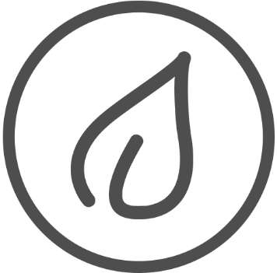


Slide 2
Philippine Red Cross
Medical Missionary

Slide 3
Fevers
High Sugar
Coughs
Body Pain
Illnesses

Slide 4
Supplies for a week
Prescriptions
NOT ENOUGH
Medical Missions
for a day

Slide 5
Poverty Stricken Locations
Lack Medical Supplies
Health Centers
Clinics
Emergency Rooms

Slide 6
Imagine yourself
Having an illness
With only a week supply of medicine.

Slide 7
WHAT WILL HAPPEN IF YOU RAN OUT OF MEDICINE?

Slide 8

Philippine Institute of Traditional and Alternative Health Care
Goal:
To inject traditional medicine into the
primary healthcare system of the Philippines

Slide 9

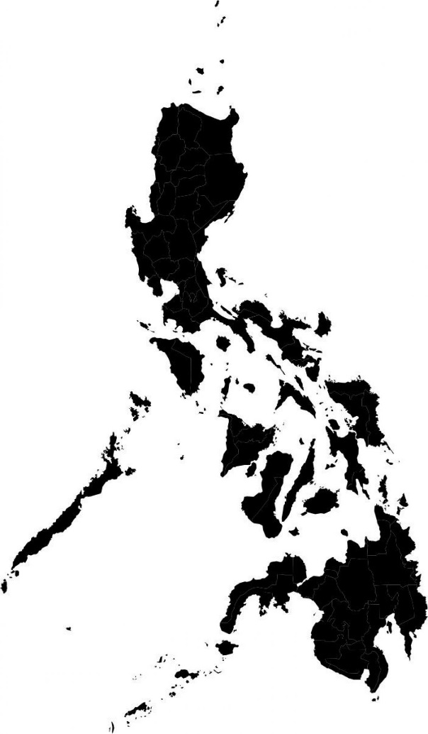
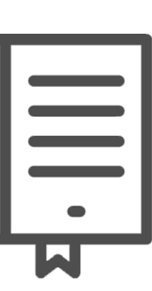


PATNUBAY SA PAGGAMIT NG HALAMANG GAMOT
HERBAL MEDICINE PRACTICES

Slide 10
Researched on herbal medicine for
10
common abundant Philippine plants
6
9
7
4
8
5
3
DOH Approved
reasons

Slide 11
CULTURE

Slide 12
AVAILABILITY

Slide 13
PRICE

Slide 14
CHALLENGE

Slide 15

BPI
B
P
I
Bureau of Plant Industry
Botanists identify most plants visually.

Slide 16
Doctors or patients don’t always have a botanist.

Slide 17
LYF
Live a better life with Lyf

